Slide 1
Curves and Surfaces

Slide 2
Curves and Surfaces
Need for Parametric Equations
Affine Combinations
Bernstein Polynomials
Bezier Curves and Surfaces
Continuity when joining curves
B Spline Curves and Surfaces

Slide 3
Need for Parametric Equations
Traditionally we’ve been using functions of the form y = f(x), good to illustrate mathematical concepts but are restrictive.
Restrictive in the sense we can have only one value of y for each value of x. (not good for representing curves)
Parametric curves are defined using a parameter ‘t’ and have defining function for each of the coordinate for a certain point
x = f(t)
y = g(t)
where t is usually restricted to an interval t:[a;b]
Frequently a parametric curve is written as (x(t),y(t)), emphasizing the two functions that define the curve, or is written P(t), where P is a two-dimensional point .

Slide 4
Need for Parametric Equations
For parametric representations of surfaces, we use two parameters, say u and v , and represent the surface as
x = f ( u,v )
y = g ( u,v )
z = h ( u,v )
for some functions f , g , and h , and where u and v are contained in some intervals, u:[a;b],
v:[c;d]

Slide 5
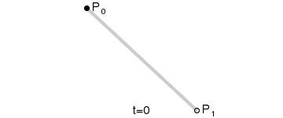
Parametric equation for a Line
Given two points P₀ = (x₀,y₀) and P₁ = (x₁,y₁) we can form a straight line by
(x,y) = (1-t).(x₀,y_{o}) + t.(x₁,y₁)
= ((1-t).x₀ + t.x₁, (1-t).y₀ + t.y₁)
Where t [0,1]
Here,
f(t) = (1-t).x₀ + t.x₁
g(t) = (1-t).y₀ + t.y₁ in the definition above.
We can also write the above line as
P(t) = (1-t)P₀ + t.P₁

Slide 6


Affine Combination
In mathematics, a linear combination of vectors x₁, ..., x_{n}
is called an affine combination of x₁, ..., x_{n} when the sum of the coefficients is 1, that is,
In case of our line defined on the previous page,
P(t) = (1-t) P₀ + tP₁ is an affine combination with
a₁ = (1-t) and a₂ = t, and a₁ + a₂ yields in 1.
`

Slide 7
Convex Combinations
Given a set of points P₀,P₁, …P_{n}, we can form affine combinations of those points by selecting a₀,a₁,….a_{n} with a₀ + a₁ + .. + a_{n} = 1 and form new points
P = a₀P₀ + a₁P₁ + … + a_{n}P_{n}
If each a_{i} is such that 0 <= a_{i} <= 1, then each generated point P is called a convex combination of the points P₀,P₁,…, P_{n}
Given any set of points, we say that the set is convex , if given any two points of the set, any convex combination of these two points is also in the set.

Slide 8
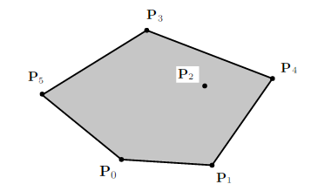
Convex Hull
The set of all points P that can be written as convex combinations of P₀,P₁,.., P_{n} is called the convex hull of the points P₀,P₁, .., P_{n}. The convex hull is the smallest convex set that contains all the set of points P₀, P₁, .., P_{n}

Slide 9
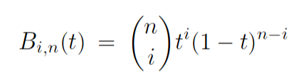

Bernstein Polynomials
The Bernstein Polynomial of degree n are defined by
for i=0,1,…..n, where
There are n+1 nth-degree Bernstein polynomials. And if i<0 or i>n B_{i,n}=0
Bernstein Polynomials of degree 1 | Bernstein Polynomials of degree 2
B_{0,1} = 1-t B_{1,1} = t | B_{0,2} = (1-t)² B_{1,2} = 2t(1-t) B_{2,2} = t²

Slide 10
Bezier Curve
To define a Bezier Curve of degree n we need a set of n+1 (P₀,P₁,..,P_{n}) control points.
The points P₀ and P_{n} are the extremities of the curve, none of the other points fall on the curve, but they act as points of attraction for the curve.
The degree of the Bezier curve is equal to the number of control points of the curve.

Slide 11
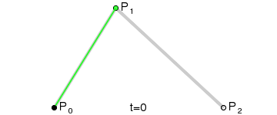
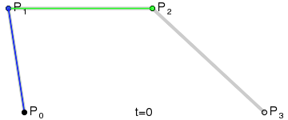
Bezier Curve
Quadratic Bezier Curve
Degree of polynomials = 2
Order (k) = 3
Number of Control points = k = 3
Cubic Bezier Curve
Degree of polynomials = 2
Order (k) = 4
Number of Control points = k = 4

Slide 12
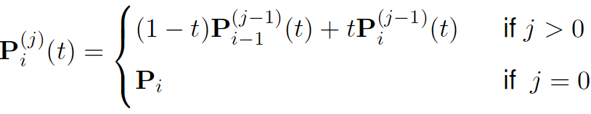
Bezier Curve
Definitions for the Quadratic Bezier Curve
  The Analytical Formula
  The Geometric Construction Formula

Slide 13
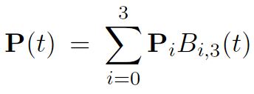
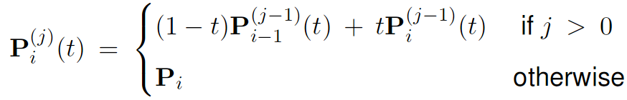
Bezier Curve
Definitions for the Cubic Bezier Curve
  The Analytical Formula
  The Geometric Construction Formula

Slide 14
Bezier Curves
A few traits
  Has global propogation
  i.e. All the control points are responsible for the curve, changing even one points affects the whole curve
  The degree of polynomials defining the curve increases as the number of control points increase.

Slide 15
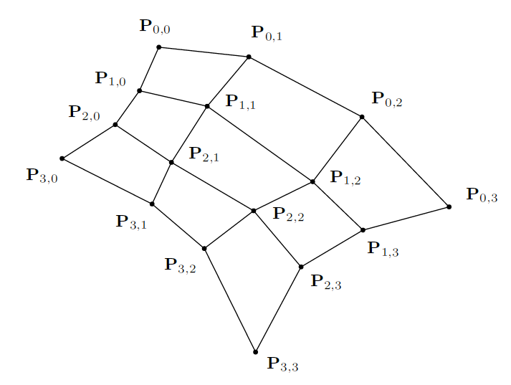
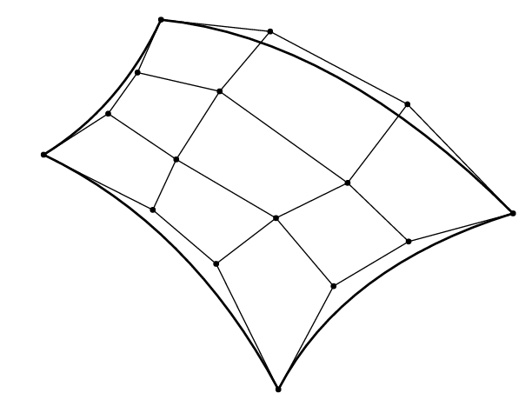
Bezier Surfaces
The extension of Bezier curves to surfaces is called the Bezier surface. The surface is constructed from and (n+1)x(m+1) array of control points { P_{i,j} : 0 <=i<= n, 0<=j<=m }. The following shows a set of control points for m=n=3. There are no restrictions on the location of the control points.

Slide 16
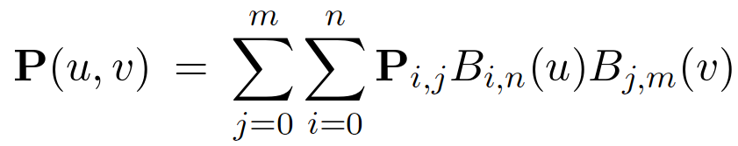
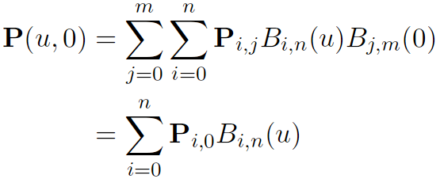
Bezier Surfaces
The surface generated by the control points is defined using two variables u and v.
If we set v equal to 0, we obtain the definition for a Bezier Curve.

Slide 17
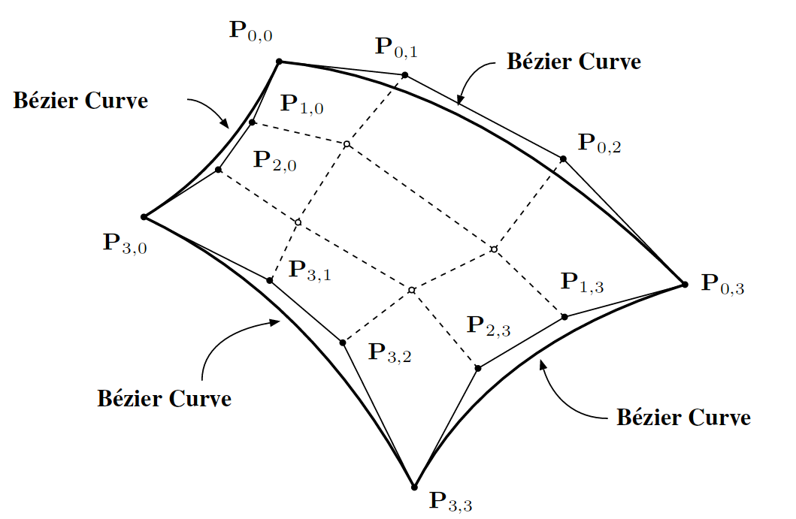
Bezier Surfaces
We observe that for extreme values of u and V, w get Bezier curves for the surface, Hence we can conclude that all the edge curves of the Bezier surface are Bezier Curves. For all P(u,0), P(u,1), P(0,V), P(1,V)
It also implies that the corner points are actually on the patch.

Slide 18
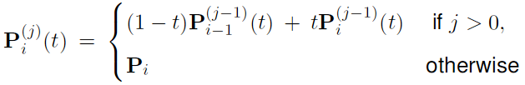
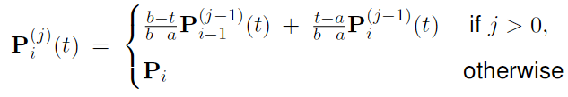
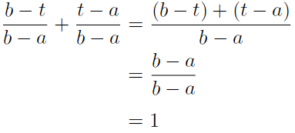
Transitioning to B-Spline Curves
Changing the parameterization of the Bezier curve
  We’ve seen that the parameter ‘t’ that we used for defining Bezier curves was constrained between 0 and 1. i.e. 0 <= t <= 1
  But we may need to define the Bezier curve between an arbitrary interval of a and b so that a <= t <= b, for this we need to change our Bernstein polynomials. This can easily be done by using following definition
  Note that the new polynomials will still make an affine combination

Slide 19
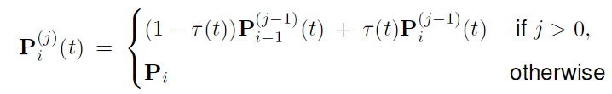
Transitioning to B-Spline Curves
Thus we can define a function τ(t) where
τ(t) = t-a / b-a and redefine the equation for our curve as.
We’ve parameterized the equation of the curve to work over the interval [a,b]

Slide 20
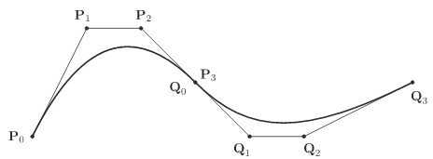
Continuity of Curves
Consider the two curves in the example below defined by their own set of control points
P(t) : {P₀,P₁,P₂,P₃} and Q(t):{Q₀,Q₁,Q₂,Q₃}.
Consider t for P(t) lies in the interval [a,b] and t for Q(t) lies in the interval [b,c]. If we were to patch these curves together we’ll need to define another curve R(t) operating over the interval [a,c]
In order for R(t) to be C⁰ continuous we’ll need to make sure P₃ = Q_{0,} so there are no breaks in the curve.
In order for the curve to be C¹ continuous, we’ll need to make sure the 1st derivatives at P₃ and Q₀ are same as well. i.e. P₃’ = Q₀’
In order for the curve to be C² continuous, we’ll need to make sure the 2nd derivatives at P₃ and Q₀ are th same as well i.e P₃” = Q₀”

Slide 21
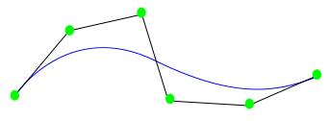
B-Spline Curves
For a B-Spline curve we’re given a set of n+1 control points {P₀,P₁,..,P_{n}}, the desired order of the curve ‘k’ (This is new!!). And a set of n+k+1 knots {t₀,t₁,...t_{n+k}}
We’ll be looking at NURBS, as they are the more popular B-Splines
*Non Uniform Rational B-Splines

Slide 22
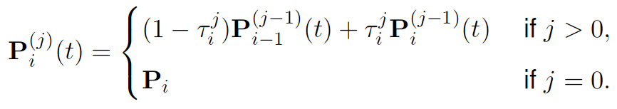

B-Spline Curves
Following is how a B-Spline curve is defined geometrically
where
and
t_{i} = 0 if i< k
t_{i} = i-k+1 if k<=i<=n
t_{i} = n-k+2 if i > n

Slide 23
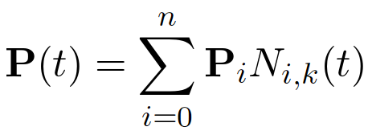
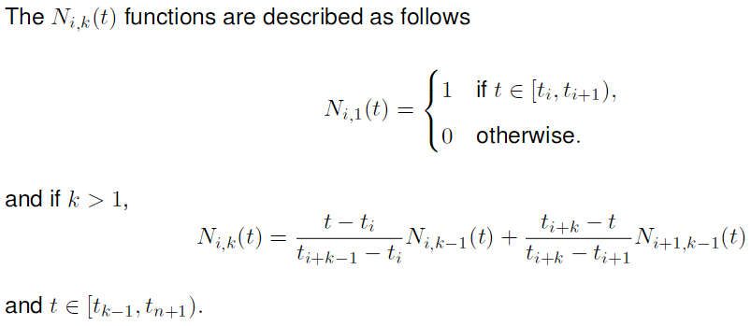
B-Spline Curves
Following is how a B-Spline curve is defined analytically

Slide 24
What’s a NURBS?
A B-Spline curve is called as a NURB if the contribution/influence of a control point to the segments of the curve vary.
But NURBS are the B-Splines that fit the Bezier curve definition.

Slide 25
B-Spline Surface
The extension of B-Spline curve to surfaces is called a B-Spline patch. The patch is constructed from an (n+1)x(m+1) array of control points {P_{i,j} : 0<=i<=n, 0<=j<=m}, an order k and two set of knots {u₀,u₁, .., u_{n+k}} and {v₀,v₁, .., v_{m+k}}

Slide 26
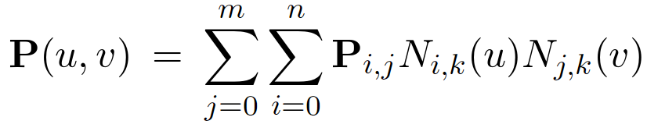
B-Spline Surfaces
Similar to the Bezier Surface but we change the equations to generate B-Spline curves instead of Bezier curves when fixing either of the u or v parameters.
Defined by the following equation
Properties of the B-spline patch are similar to the Bezier patch.
  All edge curves of the patch are B-spline curves.
  The patch is contained in the convex hull of the control points.
  By fixing u, the resulting curve is a B-spline curve on the patch.
  By fixing v, the resulting curve is a B-spline curve on the patch.

Slide 27


